Slide 1
Topic: Simultaneous equations
EQ: What are simultaneous equations?

Slide 2
When we use simultaneous equations
We use simultaneous equations to solve equations involving two or more unknowns.
In order to do this we solve two equations simultaneously
Because we are solving two equations our solution must satisfy both equations

Slide 3
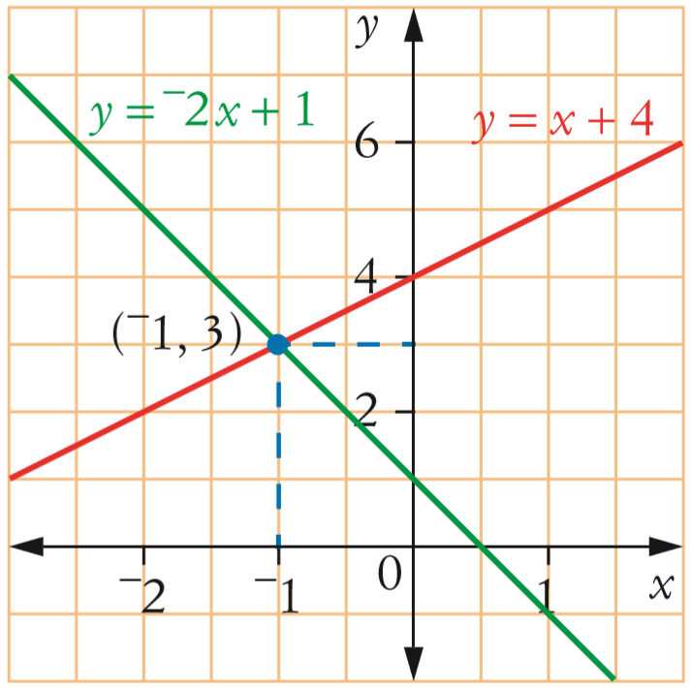
What this looks like on the graph
The solution for simultaneous equations is the point where the lines intersect
For the example on the left the point (-1,3) is the intersection point
Therefore x = -1 and y = 3, will satisfy both equations.
CHECK

Slide 4

Real world application
The Best Job for the Money
Systems of equations can be used when trying to determine if you’ll make more money at one job or another, taking multiple variables into account, such as salary, benefits and commissions.
Deciding on a Loan
Simultaneous equations can be used to determine the best loan choice to make when buying a car or a house when you consider the duration of the loan, the interest rate and the monthly payment of the loan. Other variables may be involved as well. With the information at hand, you can calculate which loan is the best choice for you.
The Best Deal
You want to find out the better deal when renting a car, and you're comparing two rental companies. By putting the variable and fixed costs, such as the per-mile and daily rate, into an algebraic expression, then solving for the total cost, you can see which company saves you money for different amounts of driving.

Slide 5


Real world application
In the Air
An air traffic controller can use simultaneous equations to ensure two airplanes don’t intersect at the same time.
AKA to make sure none of the flights are going to collide with one another.

Slide 6
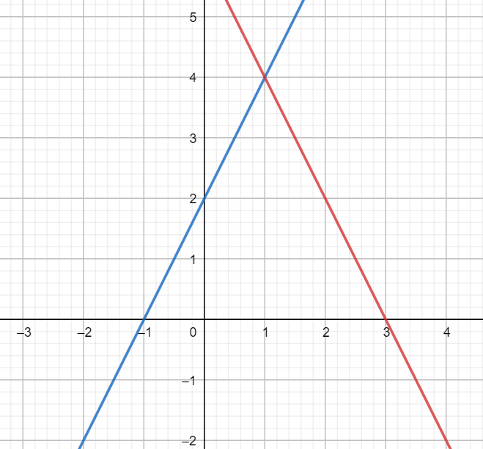
Find the solution that satisfies y=2x+2 and y=-2x+6 by graphing them

